Slide 1


Beyond the "under-desk datacentre"
LSDMA
5 Oct 2016
Lessons from research data management in the UK

Slide 2
About Jisc

Slide 3
Our vision and aim
Vision
To make the UK the most digitally advanced education and research nation in the world
Aim
We aspire to be the world class powerhouse of digital support and transformation to the UK teaching and research communities

Slide 4
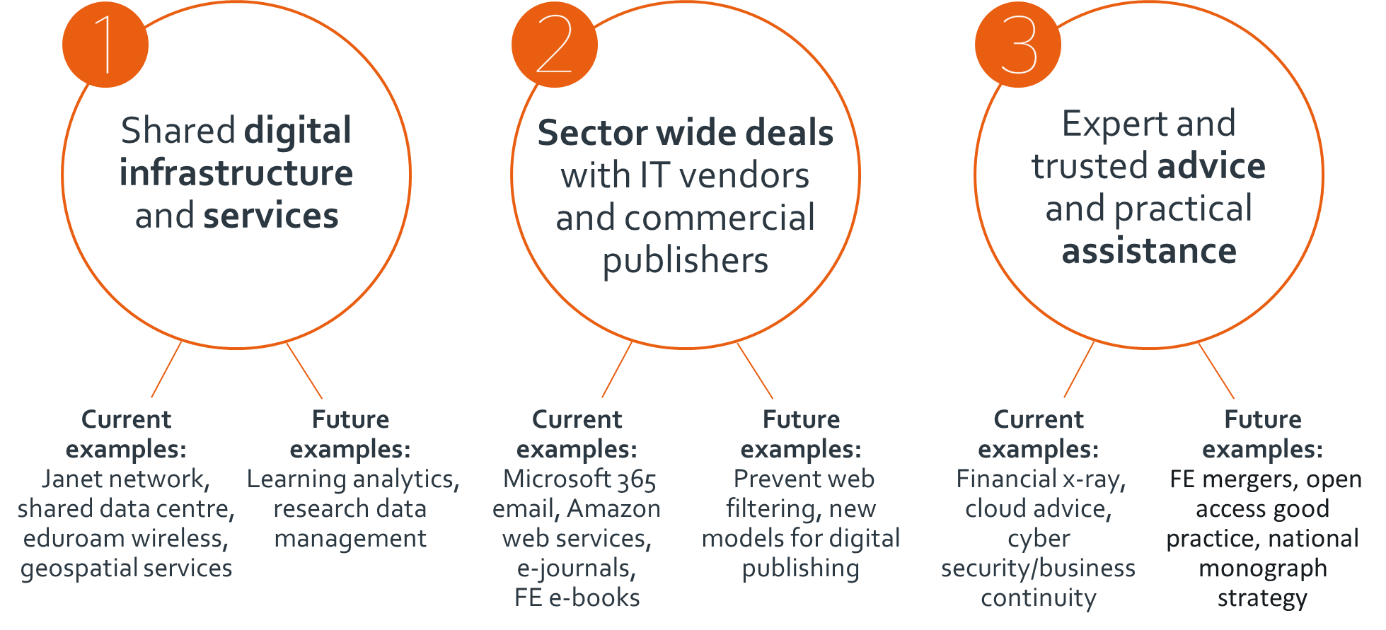
We do… three main things

Slide 5
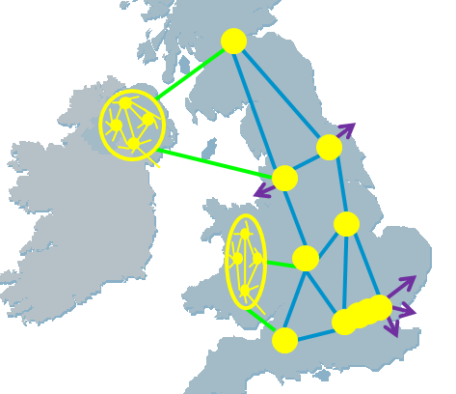
Data Movement
Janet Network:
  A core across the UK of 200Gbit/s
  19 regional distribution areas.
  Resilient
  ~900 organisations connected
  IP and circuit connection services
  ~1Tbit/s external connectivity
  Overall availability: >99.9%
  Security overlays

Slide 6

An environment for housing infrastructure
Shared Data Centre - South:
  £900K HEFCE investment
  Anchor tenants: Crick, KCL, LSE, QMUL, Sanger, UCL
    www.jisc.ac.uk/shared-data-centre
Shared Data Centre – North
  Finalising procurement

Slide 7
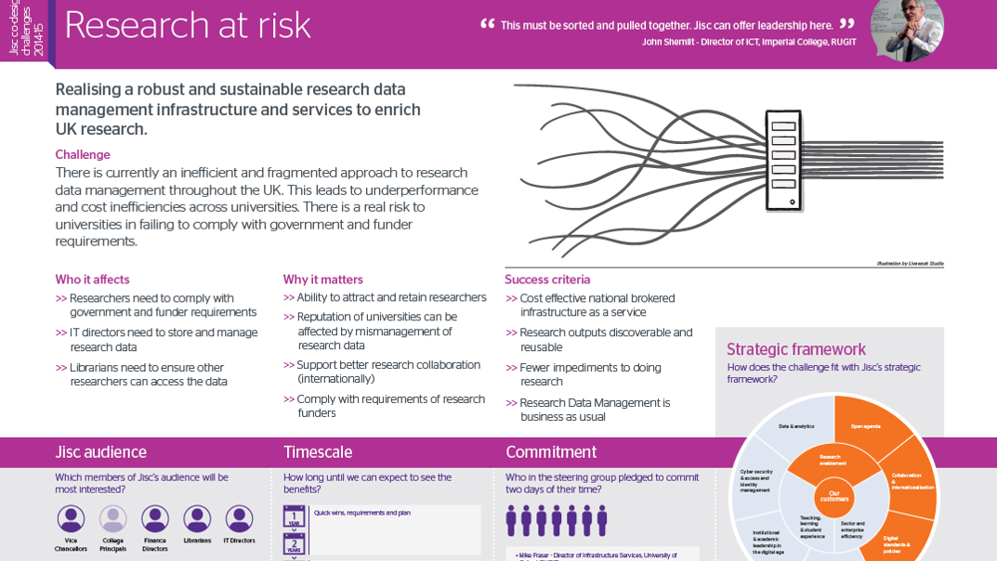

Slide 8
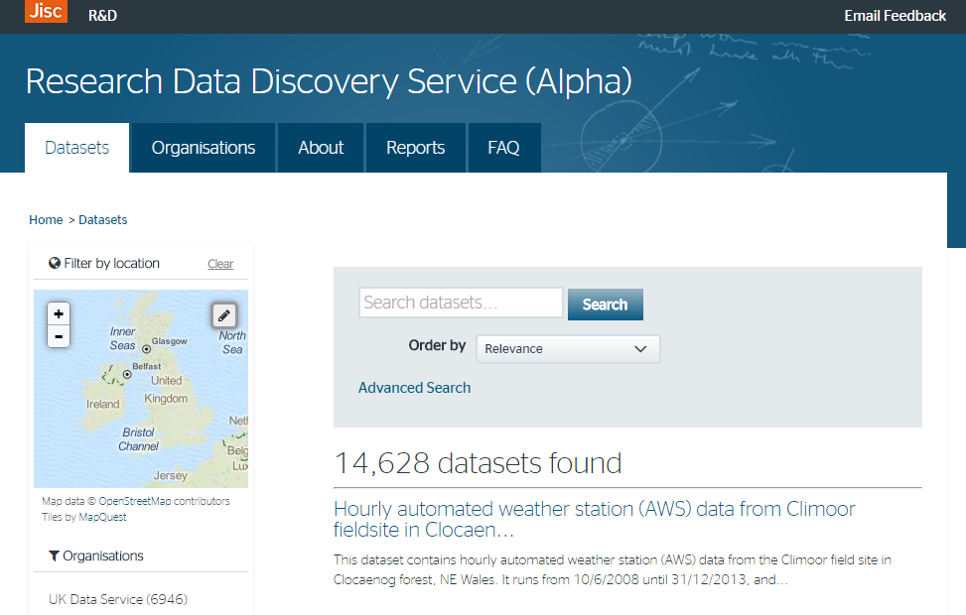
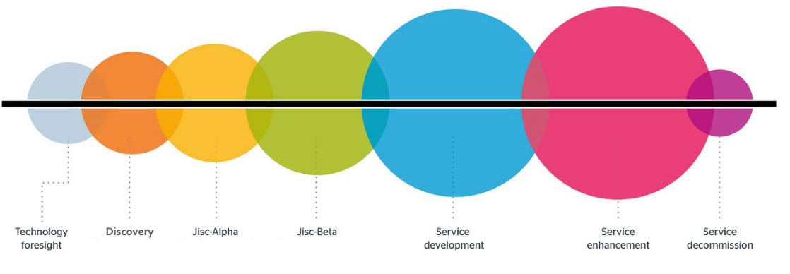
Research data discovery UK
A search tool to help researchers find research data across all UK repositories and data portals. This will encourage reuse of research data, particularly in interdisciplinary research as well as making data citation easier.
The alpha version of the service is available now, with >14k datasets aggregated.
http://ckan.data.alpha.jisc.ac.uk/dataset
Beta
Summer
2016
Service development
Early 2017

Slide 9
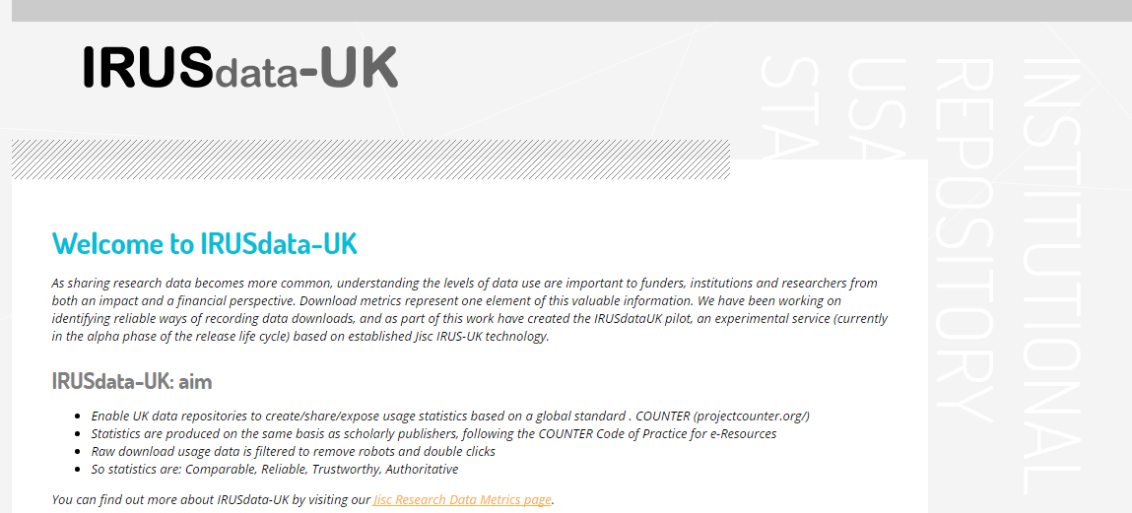
Research data usage and metrics
A prototype service for tracking usage measures and other metrics to help assess research data impact and use. Initially we will run an instance of the current repository usage statistics service (IRUS-UK) across research data repositories.
Beta
Summer
2016
Service development
Early 2017

Slide 10
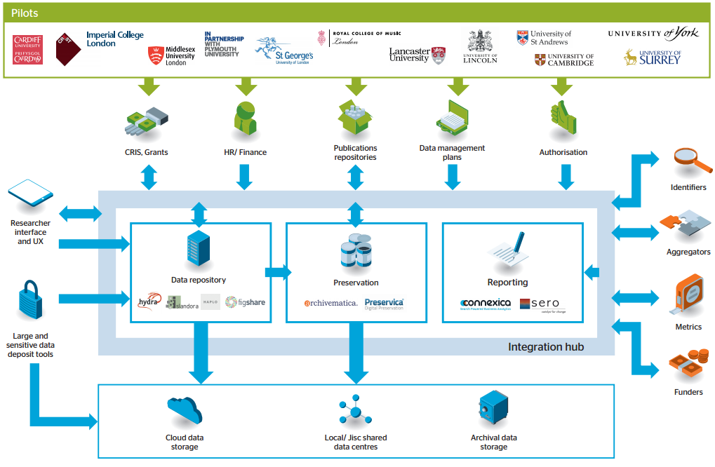
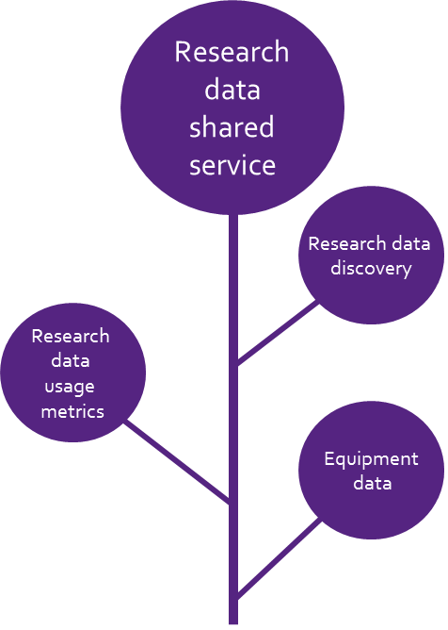
National research data shared service
https://www.jisc.ac.uk/rd/projects/research-data-shared-service
Notes:
Update on pilot on growing community

Slide 11
History

Slide 12
Why Research Data Management?
Research Excellence & Impact – data will be cited; used by others including peers, other disciplines, the public, industry, in learning – ability to meet global challenges; innovate & create new research areas.
Research integrity - replication, verification of research, improvement of methods & results.
Efficiency - save duplication of research effort, data creation & therefore costs; ease of access & re-use.
Managing risks – ability to meet FOI requests; protect reputation.

Slide 13
The reality …
Engineer “ I have lots of data but you need a licence to this bespoke software to use it”
Social Scientist- “I have notes, photos & video and audio of subjects it would take way too long to anonymise it ”
Bio-scientist- “why would I put my data in a repository? I share it informally with my peers, no-one else would understand it. “
Informatics researcher- “ yes I will share my data but people should register; & why change to the Open Data Commons licence I have a bespoke licence I have always used”
Philosopher- “I don’t have data, I annotate books”

Slide 14
“Its not just curation, retrieving and integrating data its also what we do with it!”
Jim Gray, Microsoft
  “When you go and look at what scientists are doing, day in and day out, in terms of data analysis, it is truly dreadful. We are embarrassed by our data!”
So what are the priorities?
  1. Ensuring scientifically valid processing
  2. Innovative manipulation to create new information
  3. Effective management of research data
There is a serious issue of education, training and support at undergraduate, doctoral and post-doctoral levels
Geoffrey Boulton (University of Edinburgh)

Slide 15
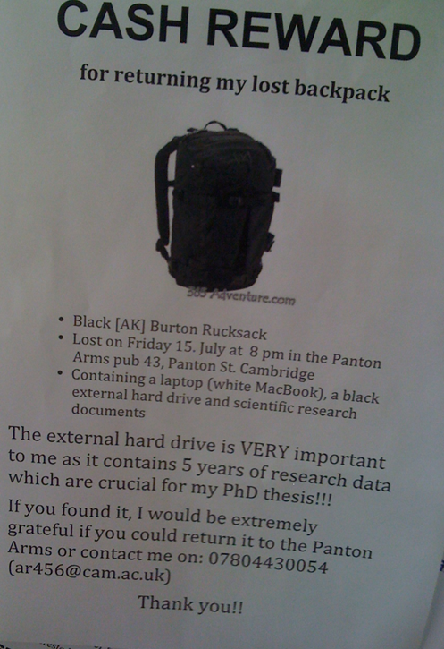
DUDs
The data centre under the desk (or in a back pack) is not adequate.

Slide 16
Evidence that significant data loss occurs
‘Departments typically don’t have guidelines or norms for personal back-up and researcher procedure, knowledge and diligence varies tremendously. Many have experienced moderate to catastrophic data loss.’
  Incremental Project Scoping Study and Implementation Plan http://www.lib.cam.ac.uk/preservation/incremental/documents/Incremental_Scoping_Report_170910.pdf
‘The current environment is such that responsibility for good data management is devolved to individual researchers and in practice PIs set the 'rules' and establish the cultural practices of the research groups and this means there is good data management practice going on in pockets but no consistency across groups. There is also consequently a high risk of data losses by a number of means’.
  MaDAM Project Requirements Analysis http://www.merc.ac.uk/sites/default/files/MaDAM_Requirements%20_%20gap%20analysis-v1.4-FINAL.pdf

Slide 17
UK Research Data Service Study - 2009

Slide 18
Jisc Managing Research Data Programme, 2011-13
Institutional RDM Infrastructure Services
17 Projects
RDM Training
5 projects
RDM Planning
10 projects
Data Publication
3 projects
Second JISC MRD Programme, 2011-13: http://bit.ly/jiscmrd2011-13
Mix of pilot projects and embedding projects.
Holistic institutional approach to RDM.
Ownership: High level ownership of the problem, senior manager on steering committee.
Sustainability: Large institutional contributions.
Develop business cases to sustain work.

Slide 19
Need for Training in RDM and Data Skills
‘data skills should be made a core academic competency’
‘data handling [should be] embedded in the curriculum’
‘There is a need to go beyond the workshop and the short training course, and embed preparation for a professional (and personal) lifetime of digital data curation within the academic curriculum.’
Graham Pryor and Martin Donnelly (2009), ‘Skilling up to do data: whose role, whose responsibility, whose career? IJDC, Issue 2, Volume 4, pp.158-170.

Slide 20
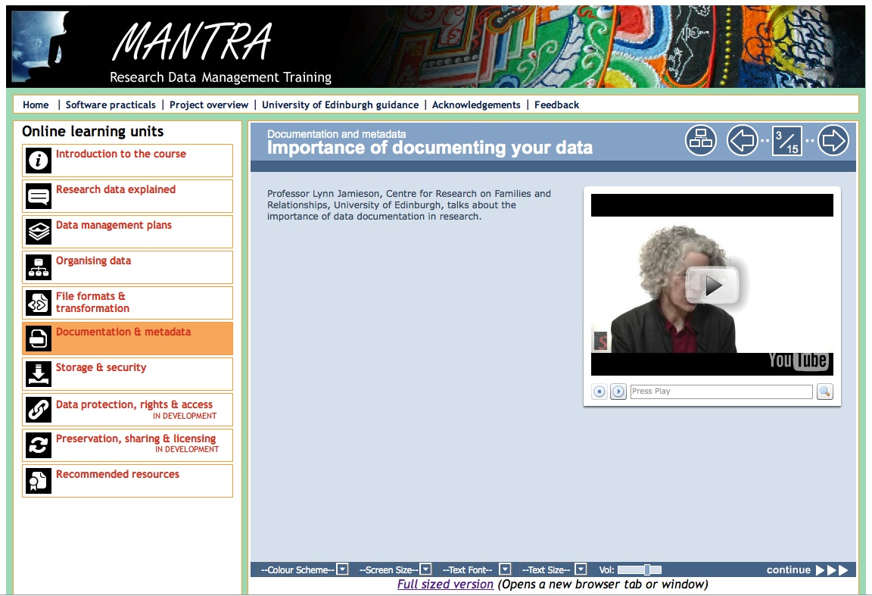
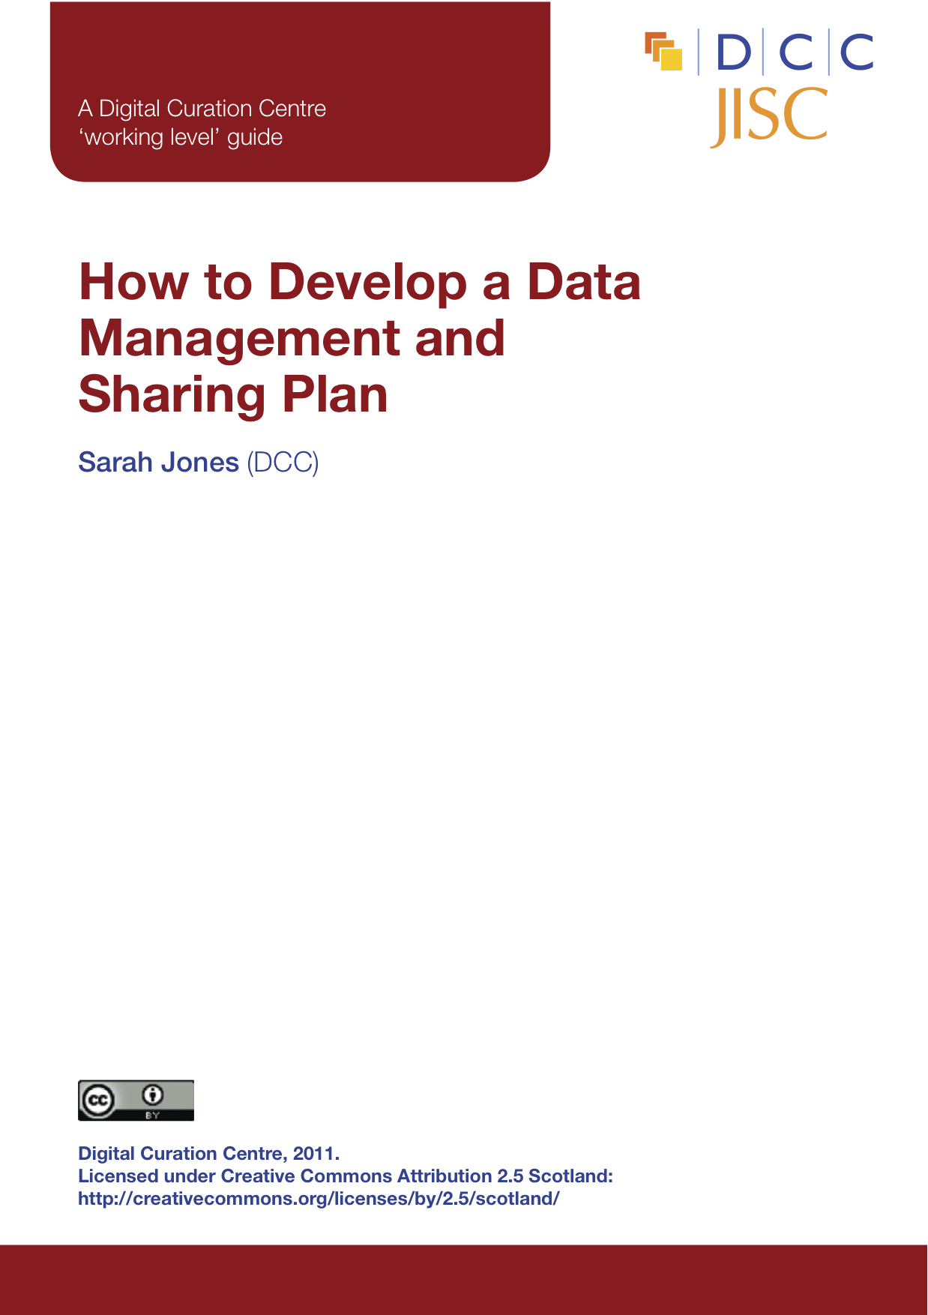
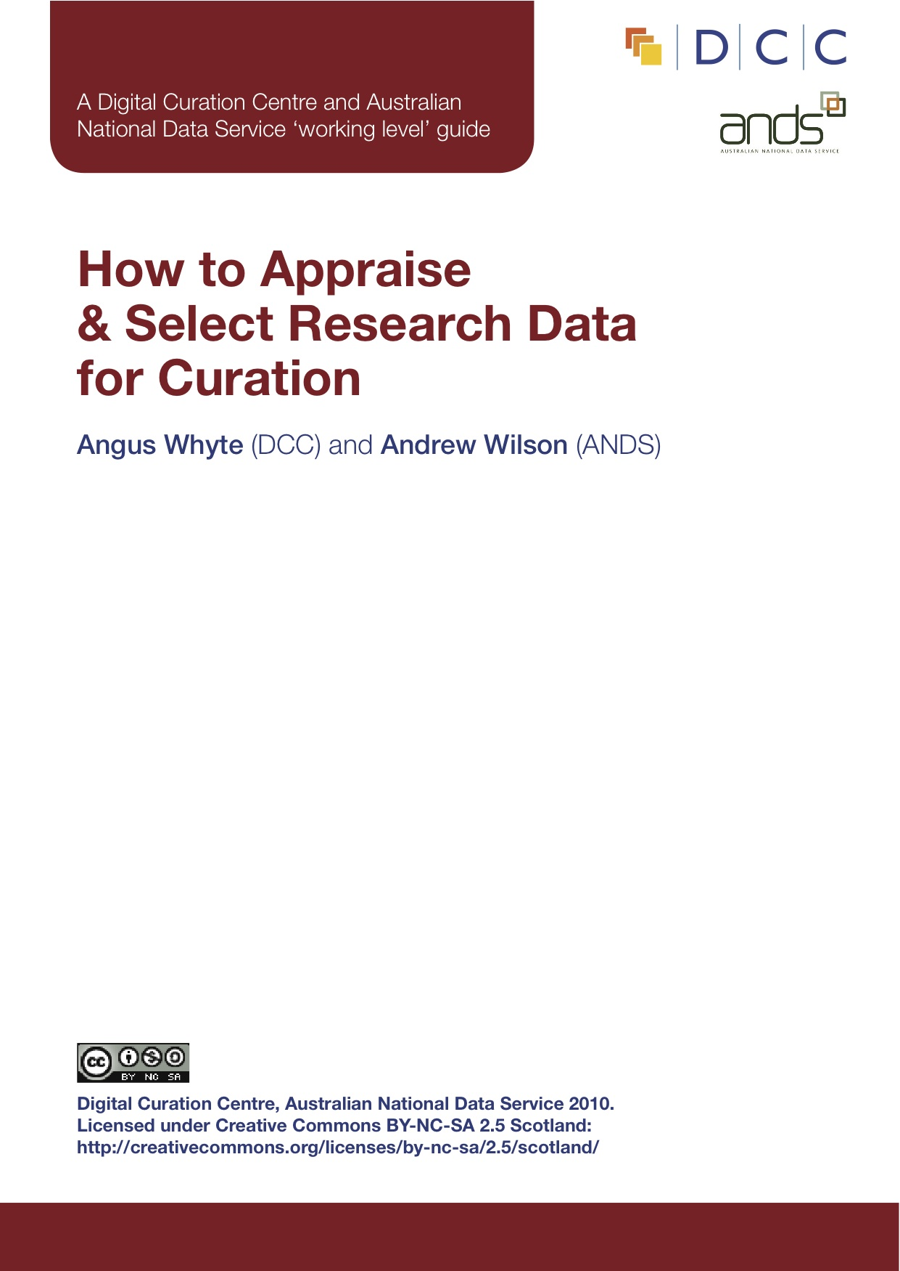
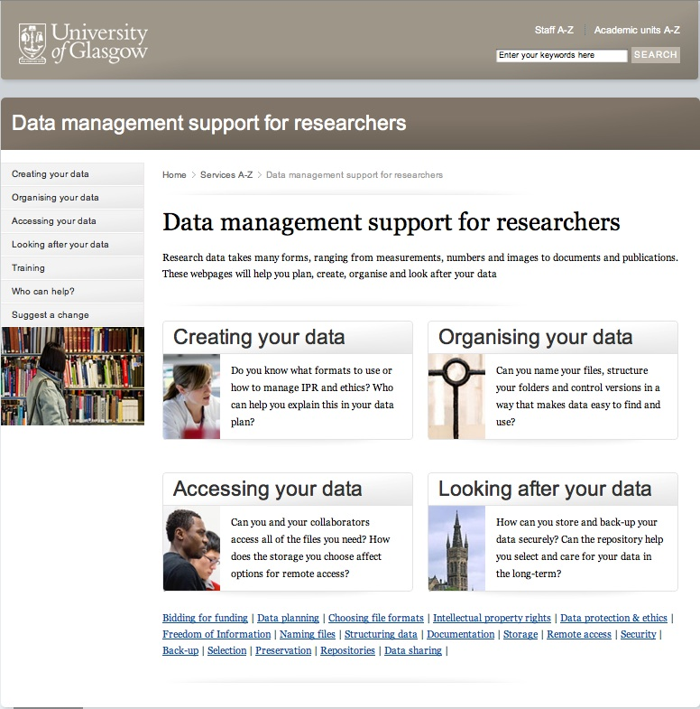

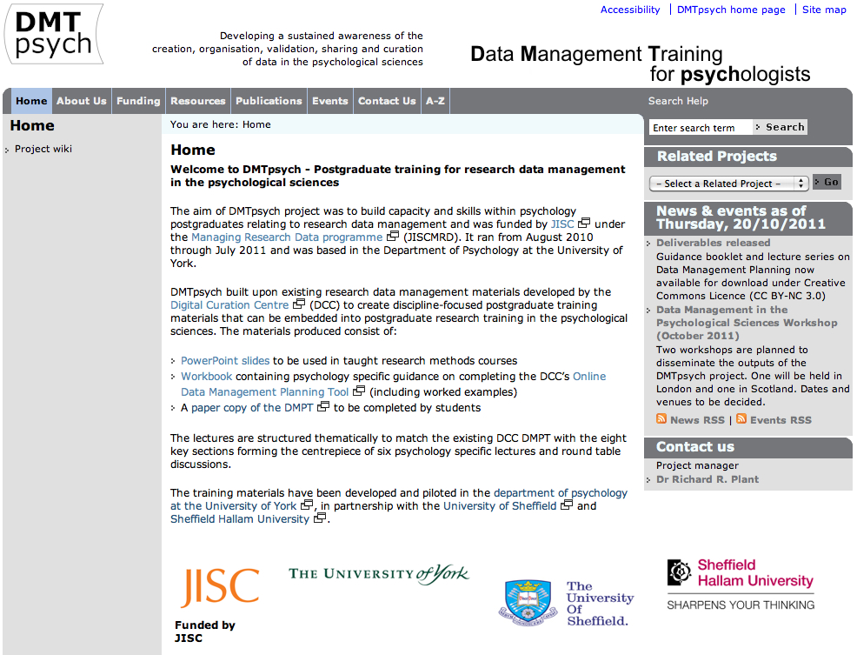
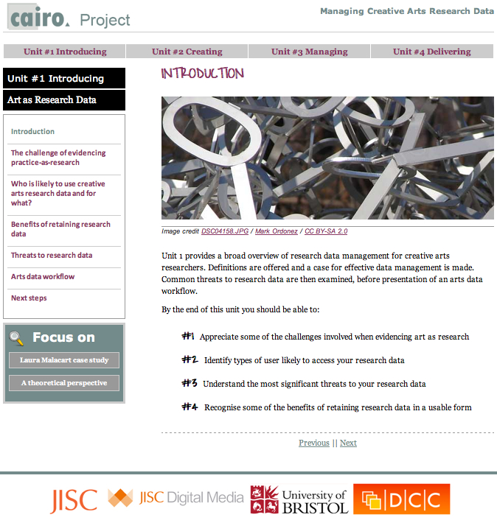
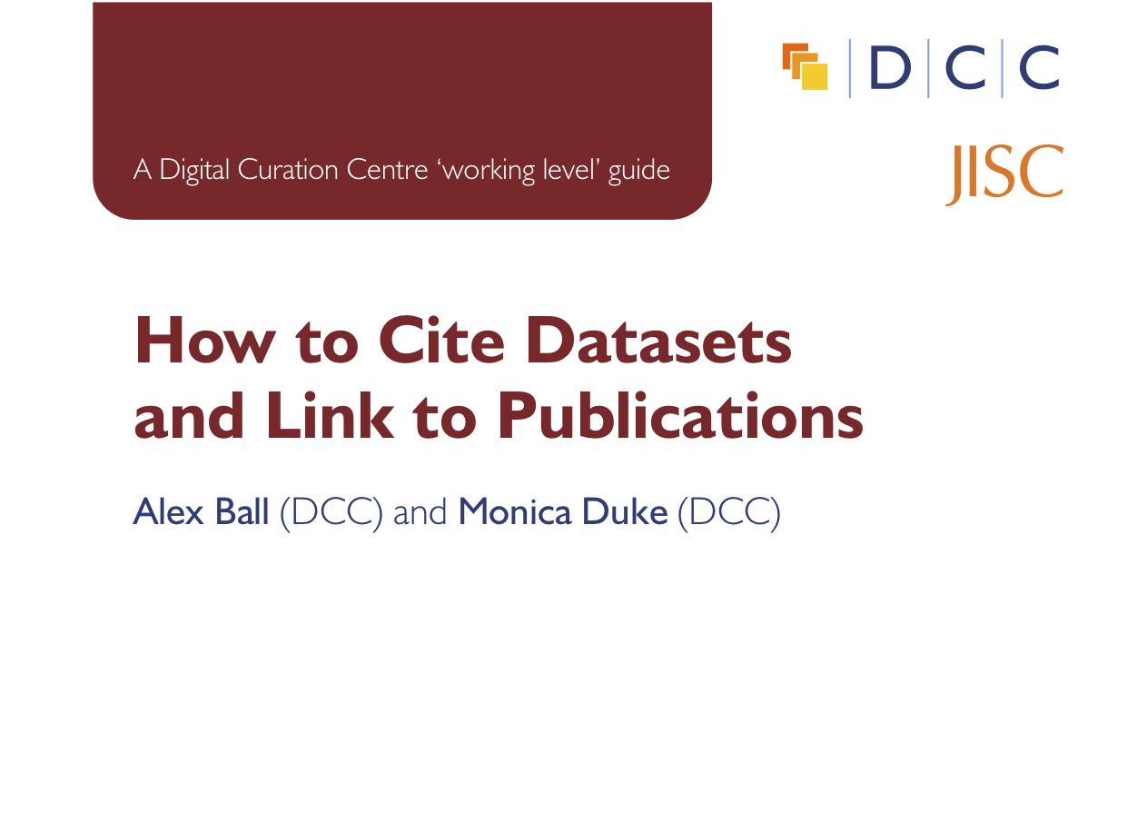
Researcher Guidance

Slide 21
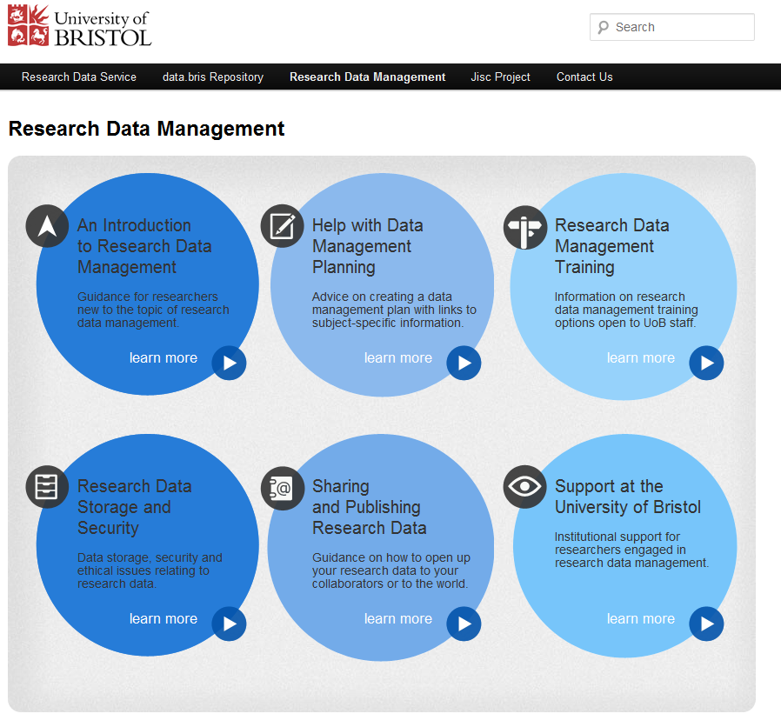
Functions of an Institutional RDM Service
Institutional Coordination
and Partnerships
Requirements
Planning
Informatics
Citation
Training
Licensing
Appraisal
Storage
Access
Impact
Liz Lyon, ‘The Informatics Transform: Re-Engineering Libraries for the Data Decade’, International Journal of Digital Curation (2012), 7(1), 126–138; http://dx.doi.org/10.2218/ijdc.v7i1.220

Slide 22


Research Data Management and Discovery Services for the Research Data Lifecycle
Key
JISC supported
Project
Other supported
Established service
Disciplinary Data Repositories (National and International)
EBI / GenBank
ICSU / WDS
UKDA, BADC
Research Data Management Applications
Institutional Data Catalogues
Institutional Data Catalogues
Research Data Management Applications
SWORD +
Metadata Exchange Between Journals, Archives, Repositories
Research Data Storage and Archival Services
Data
Data Identifiers and Metadata Schema
Data
DMP Registry
Support for Research Data Lifecycle
DMPonline
Disciplinary Research Data Discovery Services
Journal Policies Registry
Research Data Registry / Cross Repository Discovery Service
Research Data Management and Planning Services
Researchers have a cohesive and interlocking suite of research data management, publication and discovery services
Librarians and research managers have three interlocking suites of services, to support researcher needs and institutional policies
Research Data Discovery Services
Data
There is a set of infrastructure components that underpin all three suites
Researcher identifiers
Organisation identifiers
Data Identifiers
Registries

Slide 23
More visions

Slide 24
Data as New Output of Research
‘technology has enabled data to become the prevalent material and currency of research. Data, not information, not publications, is rapidly becoming the accepted deliverable of research.’
Graham Pryor, Observations on the RLUK Reskilling for Research Report
http://www.dpconline.org/newsroom/whats-new/842-whats-new-issue-44-april-2012

Slide 25

Royal Society
Science as an Open Enterprise Report, 2012
‘how the conduct and communication of science needs to adapt to this new era of information technology’.
‘As a first step towards this intelligent openness, data that underpin a journal article should be made concurrently available in an accessible database. We are now on the brink of an achievable aim: for all science literature to be online, for all of the data to be online and for the two to be interoperable.’
Royal Society June 2012, Science as an Open Enterprise, http://royalsociety.org/policy/projects/science-public-enterprise/report/

Slide 26
G8 Science Ministers Statement London UK, 12 June 2013
  Open Scientific Research Data
    To the greatest extent and with the fewest constraints possible publicly funded scientific research data should be open, while at the same time respecting concerns in relation to privacy, safety, security and commercial interests, whilst acknowledging the legitimate concerns of private partners.
    Open scientific research data should be easily discoverable, accessible, assessable, intelligible, useable, and wherever possible interoperable to specific quality standards.
    To maximise the value that can be realised from data, the mechanisms for delivering open scientific research data should be efficient and cost effective, and consistent with the potential benefits.
    To ensure successful adoption by scientific communities, open scientific research data principles will need to be underpinned by an appropriate policy environment, including recognition of researchers fulfilling these principles, and appropriate digital infrastructure.

Slide 27
And so on…
FAIR Principles
To be Findable
To be Accessible
To be Interoperable
To be Re-usable
https://www.force11.org/group/fairgroup/fairprinciples

Slide 28
The Present Context

Slide 29
EPSRC Policy
Retained EPSRC-funded research data is preserved for a minimum of ten years
Effective data curation is provided throughout full data lifecycle
Knowledge of publicly-funded research data holdings
Discoverability; recording of third party access requests
Notice and justification of access restrictions, for example ‘commercially confidential’
Awareness and use of relevant law, for example FOI
Awareness and compliance with research data policise
Adequate RDM resource allocation for example from quality-related research (QR) funding or research grants

Slide 30

Research Funder Policies
RCUK Common Principles on Data Policy
Public good: Publicly funded research data are produced in the public interest should be made openly available with as few restrictions as possible
Planning for preservation: Institutional and project specific data management policies and plans needed to ensure valued data remains usable
Discovery: Metadata should be available and discoverable; Published results should indicate how to access supporting data
Confidentiality: Research organisation policies and practices to ensure legal, ethical and commercial constraints assessed; research process should not be damaged by inappropriate release
First use: Provision for a period of exclusive use, to enable research teams to publish results
Recognition: Data users should acknowledge data sources and terms & conditions of access
Public funding: Use of public funds for RDM infrastructure is appropriate and must be efficient and cost-effective
rcuk.ac.uk/research/datapolicy/

Slide 31
Concordat on Open Research Data – July 2016
Ten principles including:
  Importance of developing data skills
  Importance of ensuring data underlying publications is accessible by publication date
  Rights of data creators to reasonable first use
  Expectations of data users to acknowledge use of others’ data

Slide 32
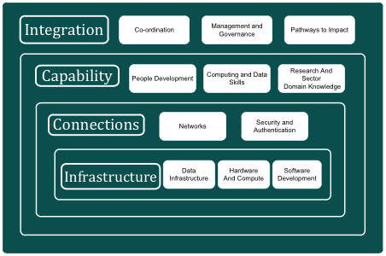
UK e-Infrastructure
Movement
Security & Assurance
Storage
Performance
Processing

Slide 33
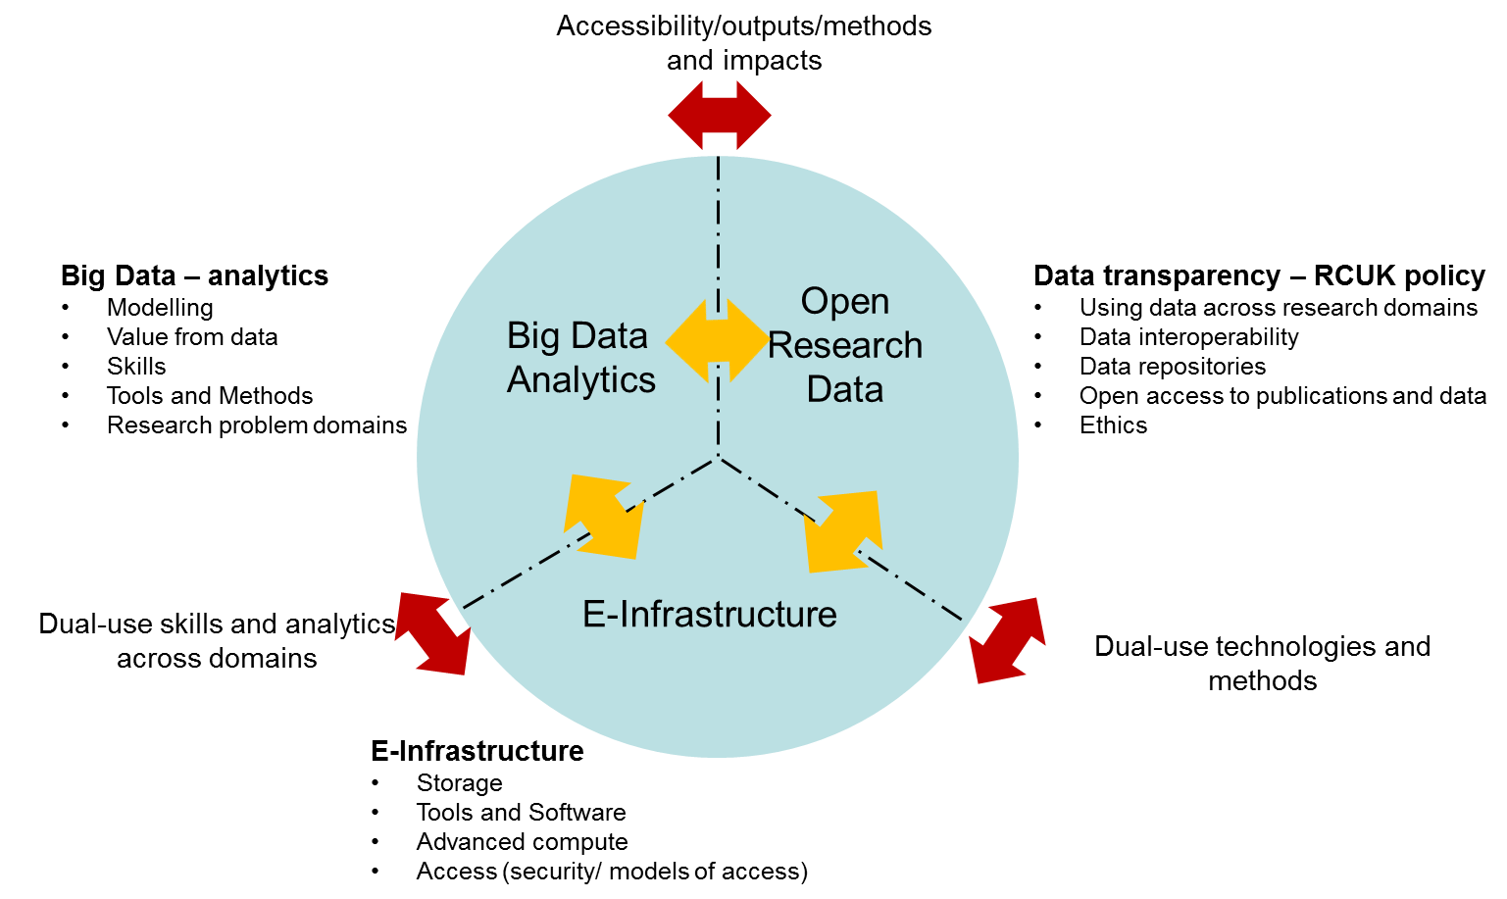
Data Infrastructure

Slide 34
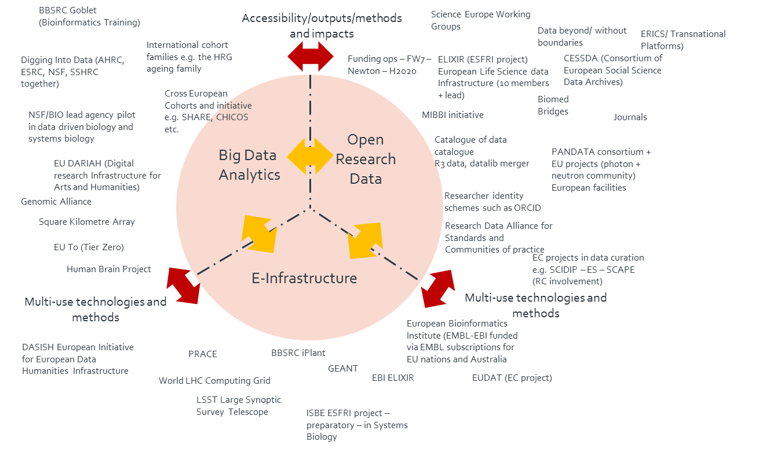
Data Infrastructure

Slide 35
Jisc Research Data Shared Service

Slide 36


Key Drivers
Better research
Lack of choice
Market gaps
Funder mandates
Efficiencies of scale
Interoperability
Notes:
There is no “solution” easily available and that meets requirements for Universities to enable Research Data Management
More effective Research Data Management must happen to comply with Funder Mandates, ensure data is not lost, and to realise a whole range of positive benefits
A shared service (provided by Jisc) offers a number of benefits
Cost savings and efficiencies
Common approaches and practice
Research system standardisation and interoperability
Address gaps in the market
Others might be found as we develop

Slide 37

Vision and Goals
Visible data, invisible infrastructure
Efficiency
Cost saving
Policy Compliance
Improved research integrity
Notes:
Vision
Researchers shouldn’t need to think (too much!) about Research Data Management
"Visible data, invisible infrastructure"
Provide researchers intuitive, easy functionality to publish, archive and preserve their research outputs.
Provide interoperable systems to allow researchers and institutions to fulfil and go beyond policy requirements and adhere to best practice throughout the RDM lifecycle.
Goals
RDM Policy compliance
Increased sector efficiencies: procurement, data re-use, interoperability opportunities
Improving the integrity of research
Addressing Market Gaps: Integrated RDM system, Preservation Gap, Usability
Accelerating Research Data Management in institutions
Supporting institutions meet Open Access/REF

Slide 38
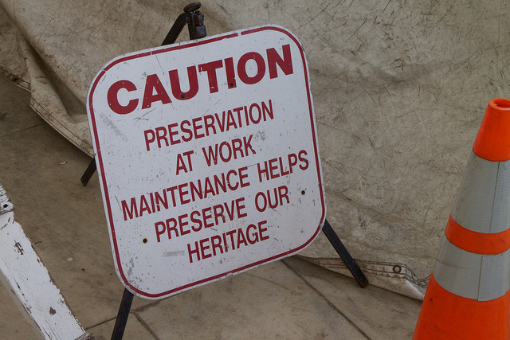
A
KEY requirement
Notes:
Preservation
This is the big GAP – many institutions are only now starting to address this need, in particular the question of what to keep (and what not to keep) and how log to keep things for.
While there are solutions like Arkivum there is a gap in terms of curating for preservation – tools that allow file format identification, metadata and the creation of archival information packages – data integrity and even emulation.
There is also a lack of:
true integration from data creation through to long term preservation
interoperability across systems
consistent UX across systems

Slide 39
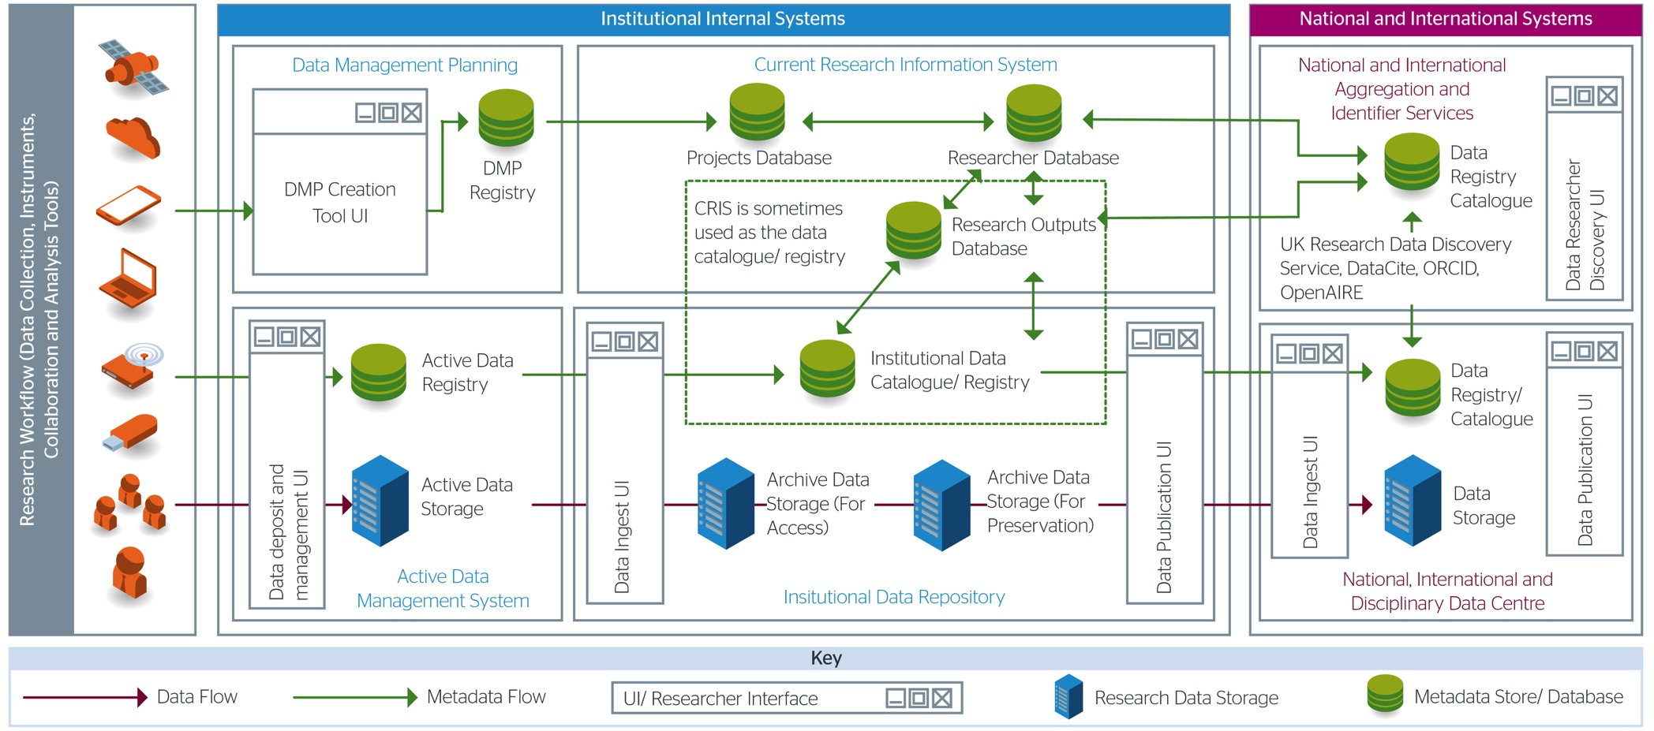
High level RDM Architecture
Credit for Architecture concepts: John Lewis (Sheffield) & Stuart Lewis (Edinburgh) http://dx.doi.org/10.6084/m9.figshare.1202230

Slide 40
Pilot Shared Service Scope
Pilot Shared Service Area
Other R@R Work Areas
Existing Jisc Services/Agreement Areas
Credit for Architecture concepts: John Lewis (Sheffield) & Stuart Lewis (Edinburgh) http://dx.doi.org/10.6084/m9.figshare.1202230
Notes:
Scope
The scope for the pilot is that of an institutional data repository taking deposits of data from the point of publication, to the preservation, access and storage of data with interoperability to systems outside.
Jisc has services and agreements in other related areas (e.g. Active data storage, Supporting DMP’s, Identifiers through ORCID, Discovery through the UK research data discovery service, usage statistics, and national data services) connections to which will be integrated into the pilot system.
Through the pilot we also hope to test and develop integrations and joins with Jisc shared data centres and Jisc open access services where feasible and applicable.

Slide 41
Interoperability and Standards
External (to the shared service) Systems
Notes:
Interoperability
Interoperability with systems can provide opportunities for efficiencies and ease of use for researchers. In many ways the integration with other existing systems is the key USP for many potential stakeholders.
The diagram above shows the 3 key underpinning platforms - repository, preservation and reporting - and the key connections to other systems and services.

Slide 42
Research Data Shared Service Timeline
Milestones 2015-18
- Support consultancy work begins
-Supplier Framework selected
-Alpha Development
-Alpha service tested and reviewed
-Beta Development
-Feedback on Beta Service
Business case decision
-If go then begin transition to production service
-Requirements - HEI Pilots Selected
-Procurement commences
Apr 2015-Dec 2015
Jan 2016 – Oct 2016
Oct-2016 -June 2017
Jul 2017-Sept 2017
Oct 2017-Apr 2018
-Institutional survey
-HEI and supplier workshops
-Pilot HEI selection process
-Detailed HEI requirements and technical architecture
-Contracting commences
-Development Phase
-Contact additional early adopter HEI’s and promote Beta Service
-Business planning and Begin Business Case
-Market Research and Consultation
-Promote service to institutions
-Start on next phases (service enhancement/modular)

Slide 43
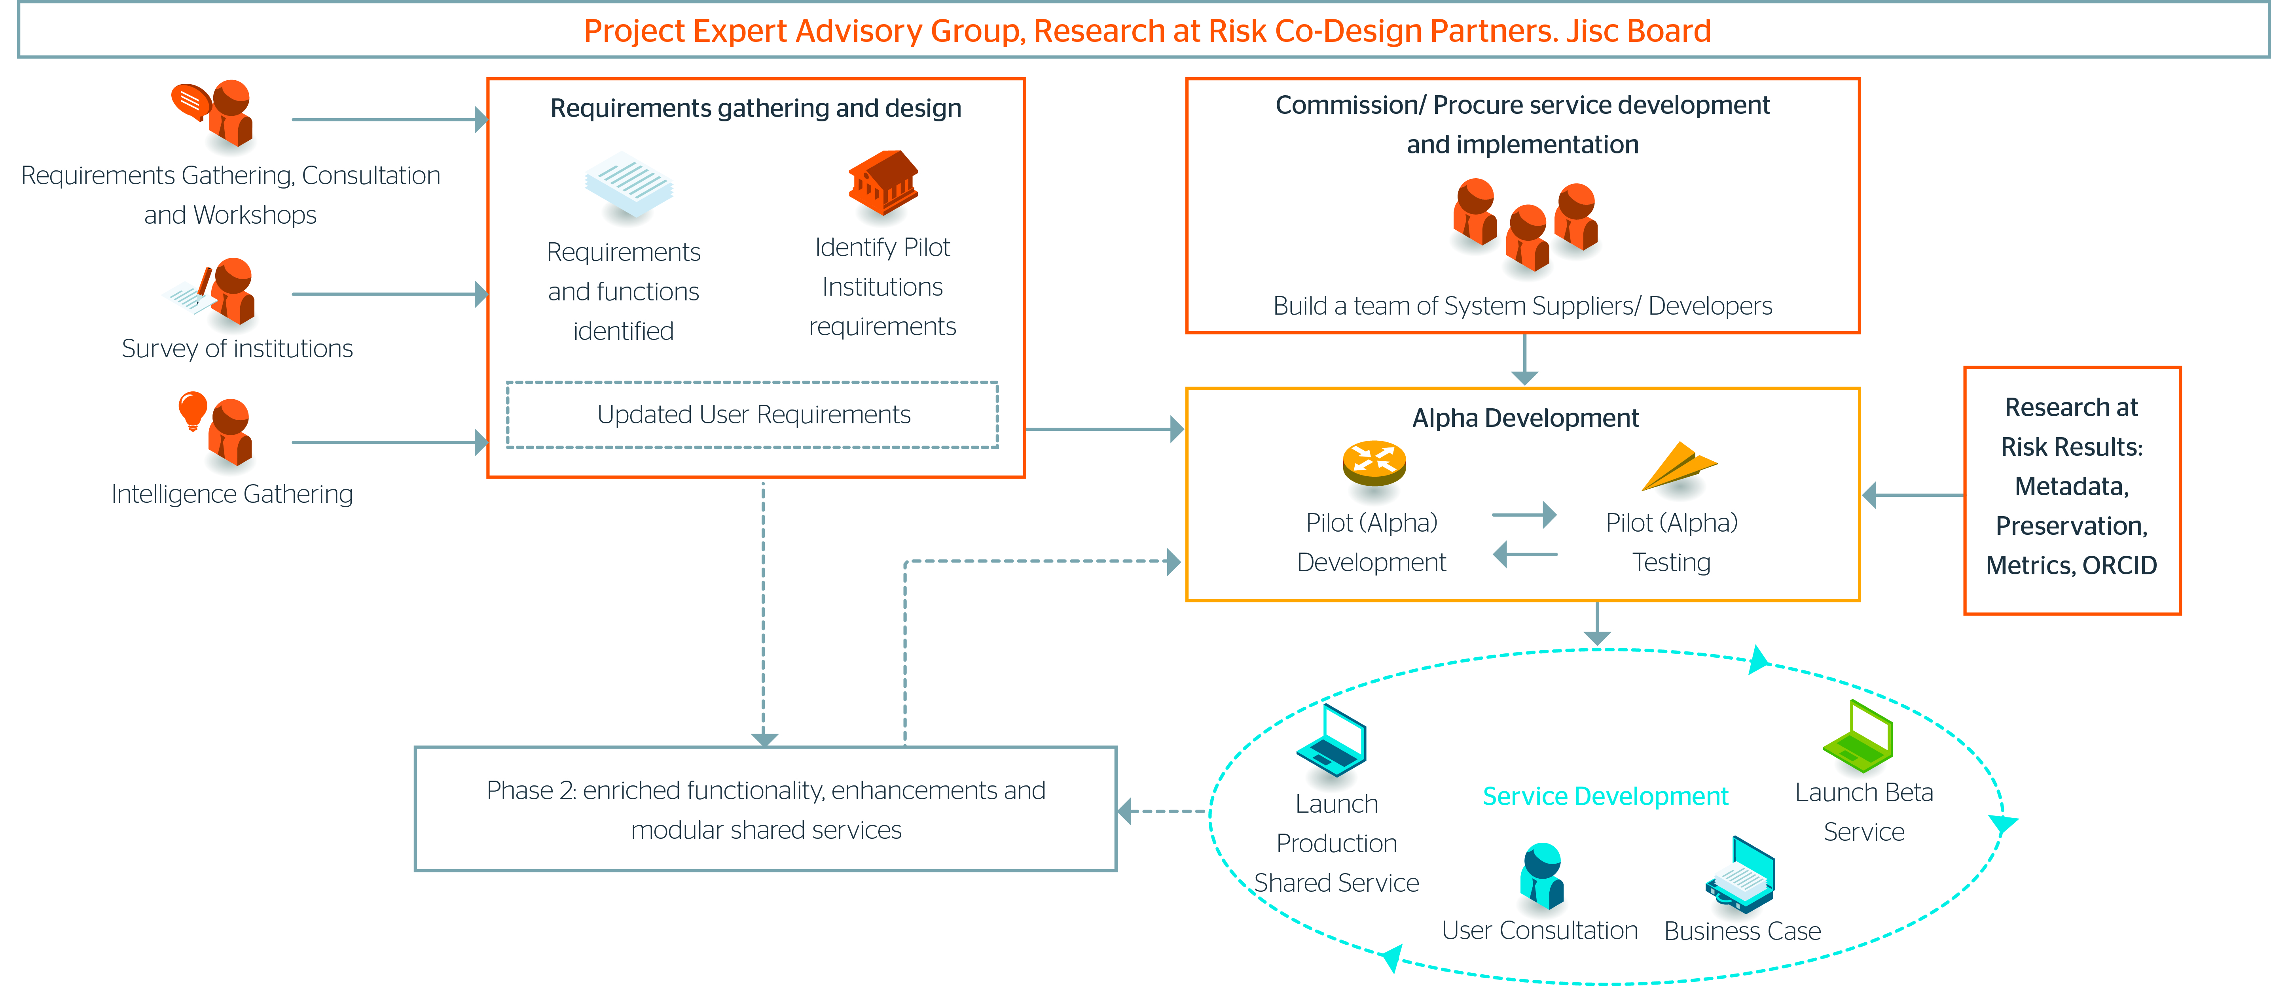
Where are we now?
✓
✓
Current activity
Notes:
Status
The pilots have been identified and appointed
The Initial requirements gathering is complete
Data Asset Frameworks (DAFs) have been completed/updated and analysed
The Metadata approach has been identified and a draft data model developed - https://github.com/jiscresearch/sharedService
Baseline costing is underway
Suppliers appointed
The initial Technical Architecture and Delivery Proposals report has been published - https://goo.gl/tZISrz
Feeds into the tech requirements of the Platform Statement of Requirements
Feeds into the specifying of integrations between platforms (both those on the Jisc framework and those that are not) that need to be developed
Will result in detailed tech architecture.
‘University of Jisc’ commissioned
Detailed requirements with all of the pilots undertaken and the MVP for the service alpha almost finalised

Slide 44

Pilots
13 Pilots
Balanced portfolio
Cardiff University
CREST
Imperial College
Middlesex University
Plymouth University
Royal College of Music
St George's Hospital Medical School
University of Cambridge
University of Lancaster
University of Lincoln
University of St Andrews
University of Surrey
University of York
Notes:
Pilots
The Pilots have been selected to cover a range of use cases – from green field, to mature provision requiring only single components – and a range of sizes – from small and specialist, through research intensive, to large colligate institutions.
Cardiff University
CREST - Consortium for Research Excellence, Support and Training (Harper Adams, St Mary’s -Twickenham, UCA & Winchester)
Imperial College of Science, Technology and Medicine
Middlesex University
Plymouth University
Royal College of Music
St George's Hospital Medical School
University of Cambridge
University of Lancaster
University of Lincoln
University of St Andrews
University of Surrey
University of York
Pilot Minimum Viable Product needs (based upon information gathered during visits to the pilot institutions which are currently being firmed up with the technical architect and HEI pilots)
Early initial views of what the MVP should cover included:
“Easy to use and cost effective archiving, ingest, preservation, repository, reporting and discovery supported that can handle sensitive data”
“Robust data storage that has growth ability for active and archive data”
“Standard metadata profile - international for interoperability”
“Integration with all main CRIS systems and PURE”
“Meets REF and funder deposit requirements (supports deposit of REF data output types)”
……EVERYTHING
As mentioned above this is now being refined and is almost finalised.

Slide 45
Working in Collaboration
8 Lots
Lot 1 - Research Data Repositories (4)
Lot 2- Repository Interfaces (6)
Lot 3 - Research Data Exchange Interface (3)
Lot 4 - Research Information and Administration Systems Integrations (1)
Lot 5 -Research Data Preservation Platforms (2)
Lot 6 - Research Data Preservation tools development (2)
Lot 7 - Research Data Reporting (2)
Lot 8 - User Experience enhancements (4)
13 Suppliers 7 Platforms
Notes:
Lots
(figures in brackets show the number of suppliers in that lot)
Lot 1 - Research Data Repositories (4)
Lot 2- Repository Interfaces (6)
Lot 3 - Research Data Exchange Interface (3)
Lot 4 - Research Information and Administration Systems Integrations (1)
Lot 5 -Research Data Preservation Platforms (2)
Lot 6 - Research Data Preservation tools development (2)
Lot 7 - Research Data Reporting (2)
Lot 8 - User Experience enhancements (4)
Underlined are the platform lots, which are existing products that can be installed straight after contracting, the other lots are development lots to provide interoperability, usability and suitability for RDM
Suppliers
Arkivum
Connexica
discoverygarden
Figshare
Haplo
Ken Chad
magneticNorth
Ocasta
Preservica
Sero
Symplectic
University of Edinburgh
University of London Computer Centre
Platforms
Lot 1 - Research Data Repositories (4)
Discoverygarden – Islandora (open source, based on Fedora)
Figshare (proprietary, hosted)
Haplo (based on RIM system used at Westminster, open source)
Sero - Hydra (open source, based on Fedora)
Lot 5 -Research Data Preservation Platforms (2)
Arkivum – Archivematica (open source preservation platform)
Preservica – (propreitary, hosted or licenced)
Lot 7 - Research Data Reporting (2)
Connexica – CXAIR (proprietary, hosted)
Sero – Edges (Also used by Jisc Monitor)
There are some consultants also working with us, these include Research Consulting who worked on the data asset framework with the pilots, and Clax who are working with Dom Fripp at Jisc on the metadata approach and data model Clax are undertaking the consultation with researchers to ensure their needs are taken into account with regards to this aspect.

Slide 46

‘University of Jisc’
Virtual iteration of the service
Using dummy (but real) data
INTEGRATION
Test environment for all stakeholders
Notes:
University of Jisc
This is a test environment (for most products) hosted on Jisc servers that will allow
Installation of platform products
The testing products with dummy (real) data
Developers to start integration work and bespoke development prior to institutional alpha deployment
A Jisc technical team – including devops and a technical integration developer - is being put in place to oversea the operation of the platform.
The environment will include installations of
Platform products
Other commonly used research systems:
Eprints
Dspace
Authentication
Arkivum Virtual Machines
Others
We will also be using it to investigate CRIS installations and other systems
It will also function as an environment where suppliers and Jisc can test their products against common systems, use cases and integrations
The MVPs based on the institutional requirements will be on boarding soon.

Slide 47
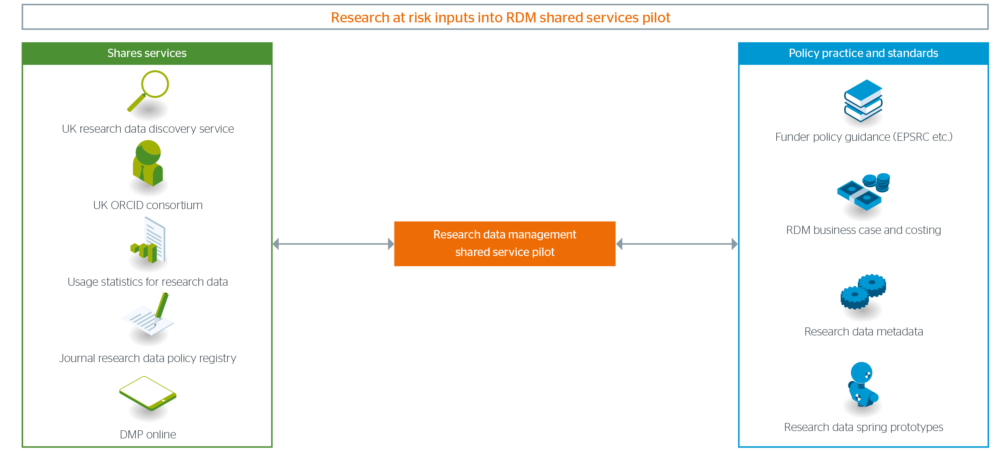
Links to Research @ Risk Portfolio
Research Data Shared Service Pilot
Notes:
Links
The project is making links between the rest of the Research at Risk portfolio, many of which are feeding outputs into the pilot, or associated guidance.
Of particular interest are:
Business case and costing for research data management
Research data spring – projects including preservation developments, data papers etc.
Research data metadata
Research data metrics for usage
UK research data discovery
Funder policy guidance

Slide 48
Governance
Jisc
Board
Research at Risk Oversight Group
Core team and developers
Research Data Service Expert Advisory Group
Notes:
Expert Advisory Group Membership
Peter Tinson (Chair) - Executive Director - UCISA
Andy Turner - Researcher, School of Geography - University of Leeds
Chris Awre - Head of Information Management - University of Hull
Daniel Hanlon - Research Data Storage Architect - University College London
Dave Golding - Enterprise Architect - University of Leeds
Jenny Evans - Research Information Manager - Middlesex University
Jenny Mitcham - Digital Archivist - University of York
Jez Cope - Data Manager – University of Sheffiledl
John Kaye - Senior Co-Design Manager - Jisc
Jonathan Rans - Institutional Support Officer - Digital Curation Centre
Kathleen Shearer - Executive Director - Confederation of Open Access Repositories (COAR) (Canada)
Masud Kokhar - Head of Digital Innovation - Lancaster University
Paul Wheatley - Head of Research & Practice - Digital Preservation Coalition
Rachel Bruce - Deputy Director of Innovation - Jisc
Robin Green - Director of Library Services - Warwick University (SCONUL)
Steve Crouch - Software Architect and Research Software Group (RSG) Lead - Software Sustainability Institute
Stuart Lewis - Deputy Director Library & University Collections - University of Edinburgh
Tim DiLauro - Digital Library Architect & Sr Technical Consultant - John Hopkins University (USA)
Valerie McCutcheon - Research Information Manager - University of Glasgow (ARMA)
Core Team
Rachel Bruce – Deputy Chief Innovation Officer
Catherine Grout – Head of Change – Research
John Kaye – Senior Co-Design Manager
Paul Stokes– Senior Co-Design Manager
Daniela Duca - Senior Co-Design Manager
Dom Fripp - Senior Curation Metadata Developer
Nikki Browne – Project Manager
[Jisc Technical Dev Ops and Dev Integrators are being put in place]
Core Team Plus
As above plus developers
Research at Risk Oversight Group
Barry Haynes
Caroline Taylor
Catherine Grout
David Prosser
Heidi Taylor-Krauss
John MacColl
John Shemilt
Kitty Inglis
Peter Tinson
Rachel Bruce
Ray Kent
Simon Kerridge

Slide 49

Engagement
Blog
Research Data Network
Research @ Risk
Shared Service web page
Notes:
Blog
https://researchdata.jiscinvolve.org/wp/
Research Data Network
http://researchdata.network
The research data network is a people network for anyone interested in Research Data Management. Although it was born from the interest surrounding the shared service, that’s just the starting point. The network holds regular events – to date there have been two (in Cardiff and Cambridge) with two more planned for the end of the year and spring next year.
Research @ Risk
https://www.jisc.ac.uk/rd/projects/research-at-risk
Shared Service Web page
https://www.jisc.ac.uk/rd/projects/research-data-shared-service

Slide 50

Thank you!
Matthew Dovey, Jisc
matthew.dovey@jisc.ac.uk
Except where otherwise noted, this work is licensed under CC-BY-NC-ND

Slide 51
Questions and discussion

