Slide 1
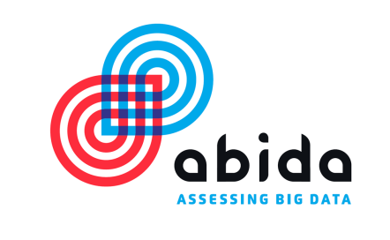
Assessing Societal Aspects of Big Data - the Project ABIDA
The Challenge of Big Data in Science
(5th International LSDMA Symposium),
The interdisciplinary project ABIDA is funded by the Federal Ministry of Education and Research (01IS15016A-F)

Slide 2
The Project
Preliminary Results

Slide 3
Partners
Karlsruhe Institute of Technology (KIT), Institute for Technology Assessment and Systems Analysis (ITAS)
University of Münster (WWU), Institute for Information, Telecommunication and Media Law (ITM), Civil Law Department
Leibniz University Hannover (LUH), Institute for Legal Informatics (IRI)
Technical University Dortmund (TU Dortmund), Faculty of Business, Economics and Social Sciences (WiSo) Technology Studies
Ludwig-Maximilians-University München (LMU), Research Center for Information, Organization, and Management (IOM)
WZB Berlin Social Science Center

Slide 4
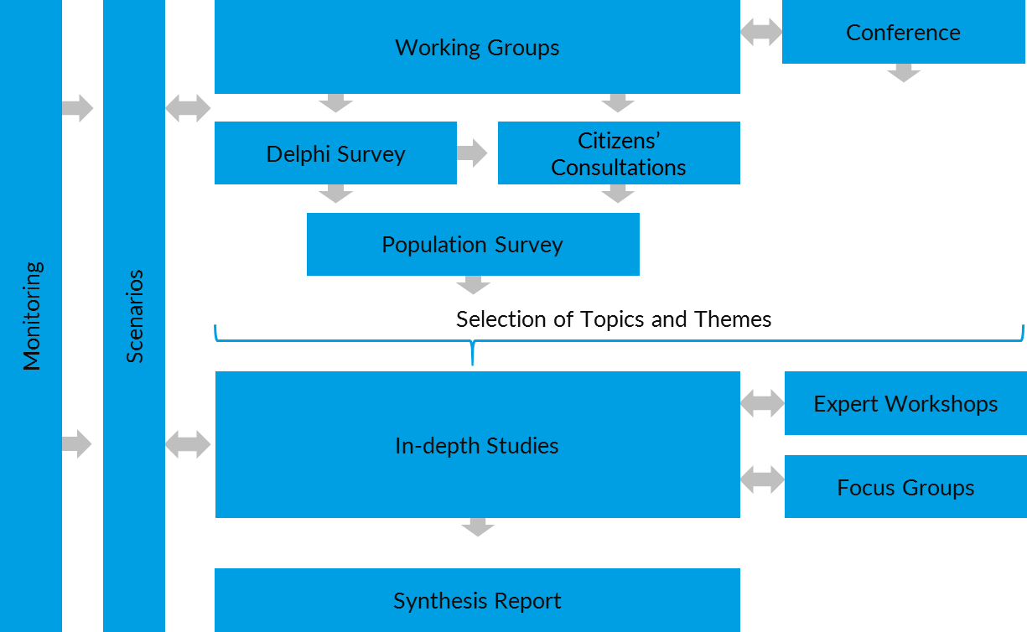
Project Structure

Slide 5
Working Groups
Law
Ethics
Economics
Sociology
Political Science

Slide 6
Project Components
Delphi Survey
Citizens Consultations
Population Survey
In-depth studies
Focus groups

Slide 7
Preliminary Results Delphi Workshop
Big Data can lead to behavioral changes
Transparency of Big Data applications
“Big Data competences”
Group specific profiling measures
Enhanced social problem-solving capacities through Big Data applications
„Big Data Divide“
Discrimination through automated decisions

Slide 8
Preliminary Results Citizen Consultations
Building trust though data privacy law
The use of non-personal data should be facilitated
The use of personal data should be regulated more strictly
The individual should be able to control what happens with their personal data
Education concerning Big Data is considered as very important
Fear of misinterpretations of data
International regulations concerning data as personal property
Global standards for collection, assessment and use of data
Disclosure of algorithms

Slide 9
Thank you for your attention!

