Slide 1
Welcome to 5th International LSDMA Symposium
“The Challenge of Big Data in Science”
Prof. Dr. Michael Decker
Head of Division 2 – Informatics, Economics and Society

Slide 2




KIT – Our Mission
  Research & Development
  Higher Education
  Innovation
3 Pillars

Slide 3


KIT in Figures
25.200
Students
Employees
9.300
850
355
Professors
Annual Budget in Million Euros
figures from winter term 2015/16

Slide 4

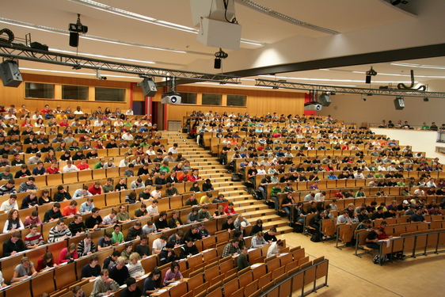
Broad Range of Educational Offers
over 80 modern degree programs in 11 departments:
  Civil Engineering, Geo- and Environmental Sciences
  Mechanical Engineering
  Informatics
  Electrical Engineering and Information Technology
  Chemical and Process Engineering
  Economics and Business Engineering
  Chemistry and Biosciences
  Mathematics
  Physics
  Architecture
  Humanities and Social Sciences
envisaged student-scientist-ratio 5:1

Slide 5
Broad Range of Educational Offers
over 80 modern degree programs in 11 departments:
  Civil Engineering, Geo- and Environmental Sciences
  Mechanical Engineering
  Informatics
  Electrical Engineering and Information Technology
  Chemical and Process Engineering
  Economics and Business Engineering
  Chemistry and Biosciences
  Mathematics
  Physics
  Architecture
  Humanities and Social Sciences
envisaged student-scientist-ratio 5:1

Slide 6

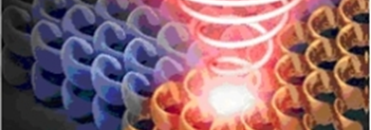





Disciplinary Strength - Transdisciplinary Focus
Divisions: Organisation according to scientific Disciplins
KIT-Centres: Strategic Research Spanning Divisionary Boundaries
Division 1:
Biology, Chem-istry, Process Engineering
Division 2: Informatics, Economics, Society
Division 3:
Mechanical and Electrical Engineering
Division 4:
Natural and Built Enviroment
Division 5:
Physics,
Mathematics
Energy
Materials ∙ Structures ∙ Functions
Elementary Particle and Astroparticle Physics
Climate and Enviroment
Mobility Systems
Information ∙ Systems ∙ Technologies
Humans and Technology

Slide 7
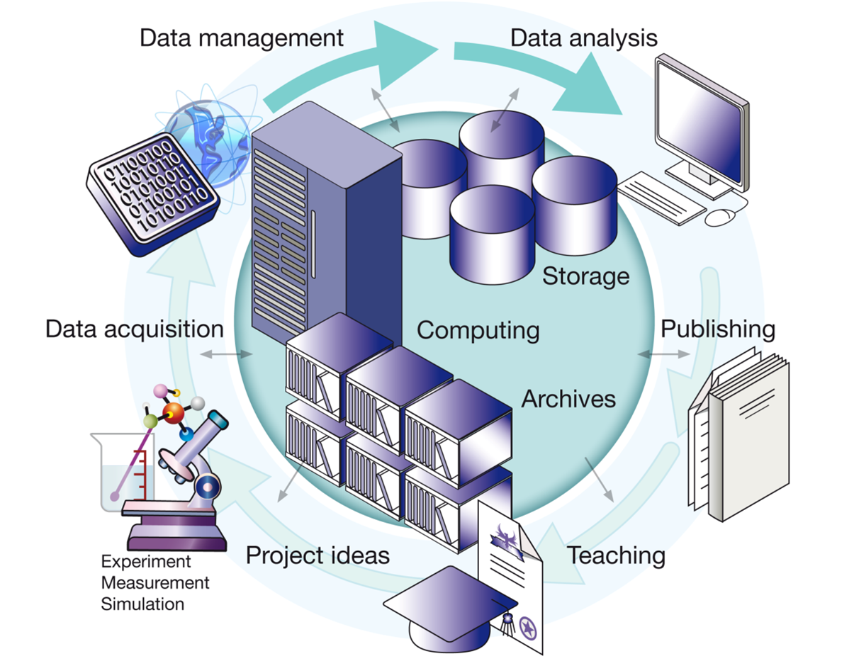
Large-Scale Data Management & Analysis

Slide 8
Large-Scale Data Management & Analysis
Fourth Pillar:
“For scientific communities the data exploration – commonly considered as the 4th pillar besides experiment, theory and simulation – is of utmost importance to gain new scientific insights and knowledge.”
Energy: smart grids, battery research, fusion research
Earth and Environment: climate models, environ. satellite data
Health: virtual human brain map
Key Technologies
Structure of Matter
Social Sciences/Economics/…

Slide 9
Thank you for your attention!

