Slide 1
User Community Driven Development in Trust and Identity
Christos Kanellopoulos (GRNET)
5th International LSDMA Symposium: The Challenge of Big Data in Science
5 October, 2016
Karlsruhe

Slide 2

The starting point
The scenario:
  There is a technical architect of a research community
  Her community is distributed internationally
  Increasing number of services need authentication
  and authorization
  Her job is to find a solution
  She wants to focus on research and not reinvent the wheel
  She starts googling
So, there are some solutions available, but…

Slide 3
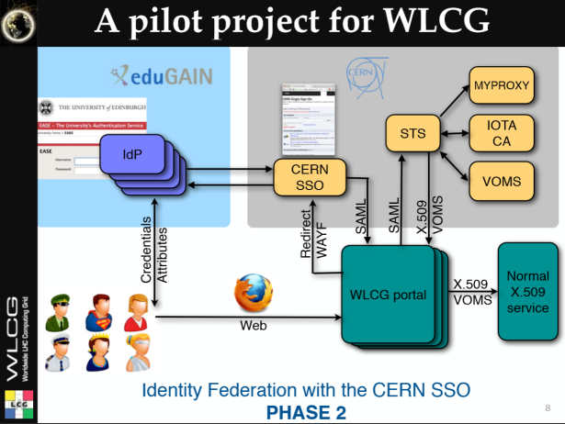















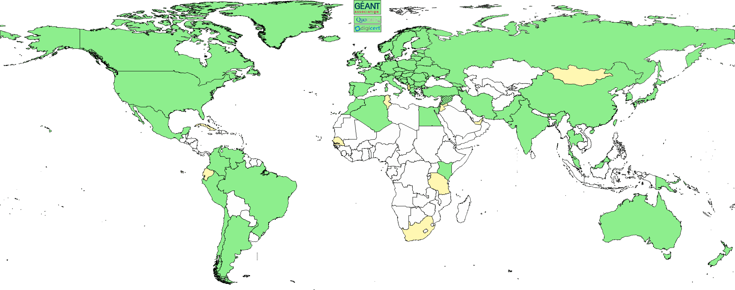





















3

Slide 4
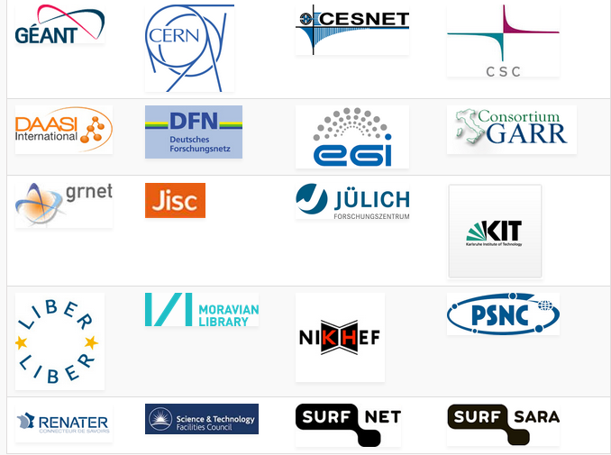
AARC Facts
Authentication and Authorisation
for Research and Collaboration
Two-year EC-funded project
20 partners
  NRENs, e-Infrastructure providers and Libraries as equal partners
About 3M euro budget
Starting date 1st May, 2015
https://aarc-project.eu/

Slide 5

AARC’s Role - Connecting the islands
  rInfra1
  eInfraA
  rInfra2
  eInfraB

Slide 6
AARC Vision and Outputs
  Avoid a future in which new research collaborations develop independent AAIs
Impact
Bring federated access and eScience close to each other
Create a cross-e-infrastructure ‘network’ for identities
Reduce duplication of efforts in the service delivery
Outputs
Design of integrated AAI built on federated access
Harmonised policies to easy cross-discipline collaboration
Pilot selected use-cases
Offer a diversified training package

Slide 7


AARC and T&I ecosystem
GN4 project, REFEDS, FIM4R, RDA, and various AAI work within other projects
Liaisons with international collaborations
AARC
REFEDS/FIM4R
r/e-Infrastructures
REFEDS:
Pilot integration results
Incorporate
Develop business case
Costing
Supply chain
Feedback and validation from Fed Operators on best practices
Training
AARC technical and policy findings
Pilots
Anchored in real use cases
Requirements
Feedback on pilots from AAI user communities
FIM4R:
Requirements/feedback for training and architecture
International collaboration

Slide 8
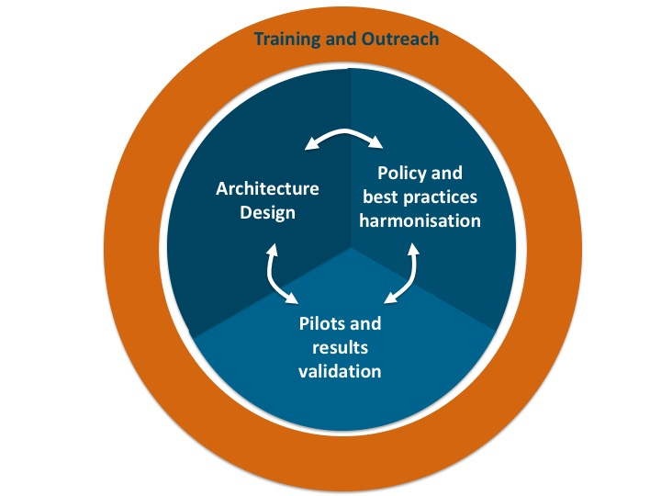
AARC Methodology
Management
Community Requirements
Community Feedback

Slide 9
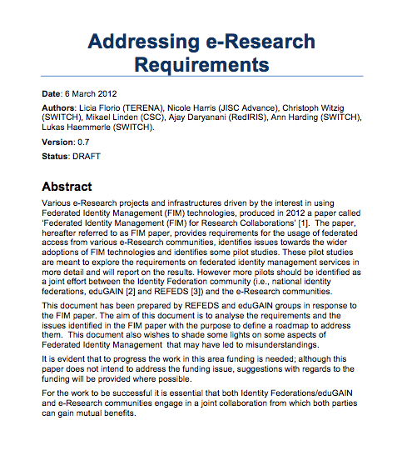

Starting Point
ID FEDs
Mainly nationally focused
Provide webSSO (SAML) to access a number of services
Support fine-grained AuthZ
e-Researcher
Typical inter-fed use-cases
Provide SSO (X.509) for e-Research services
Requirement for stronger AuthN (LoA)

Slide 10
The goals
Users should be able to access the all services using the credentials from their Home Organization
Users should have one persistent non-reassignable non-targeted unique identifier.
Attempt to retrieve user attributes from the user’s Home Organization. If this is not possible, then an alternate process should exist.
Distinguish (LOA) between self-asserted attributes and the attributes provided by the Home Organization/VO
Access to the various services should be granted based on the role(s) the users have within the collaboration
Services should not have to deal with the complexity of multiple IdPs/Federations/Attribute Authorities/technologies.

Slide 11
Identified Requirements
Attribute Release
Attribute Aggregation
User
Friendliness
SP
Friendliness
User Managed Information
Persistent Unique Id
Credential translation
Credential Delegation
Levels of Assurance
Guest
users
Step-up AuthN
Non-web-browser
Community based AuthZ
Best
Practices
Social & e-Gov IDs
Incident Response

Slide 12
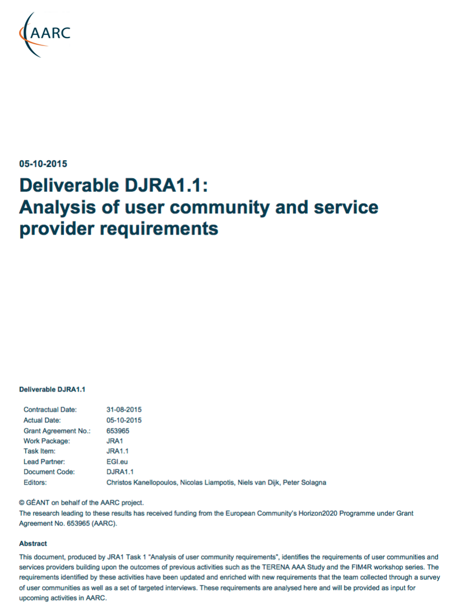
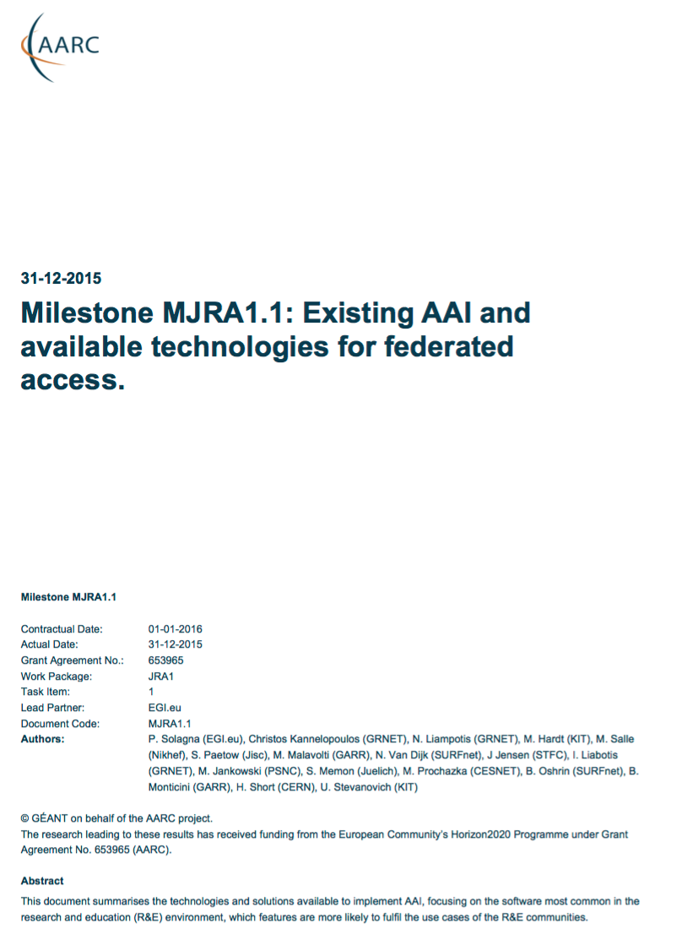
The Functional Components and available AAI tools
Analysis of
User Communities
IdPs
Available
AAI Components
Attribute Authorities
Proxies
Token Translation
And Infrastructure Providers
Service Provider
aarc-project.eu

Slide 13
AARC: Analysis of User Communities and e-Infrastructure
Providers
Attribute Release
Attribute Aggregation
User
Friendliness
SP
Friendliness
Credential translation
Persistent Unique Id
User Managed Information
Credential Delegation
Levels of Assurance
Guest
users
Step-up AuthN
Best
Practices
Community based AuthZ
Non-web-browser
Social & e-Gov IDs
Incident Response

Slide 14
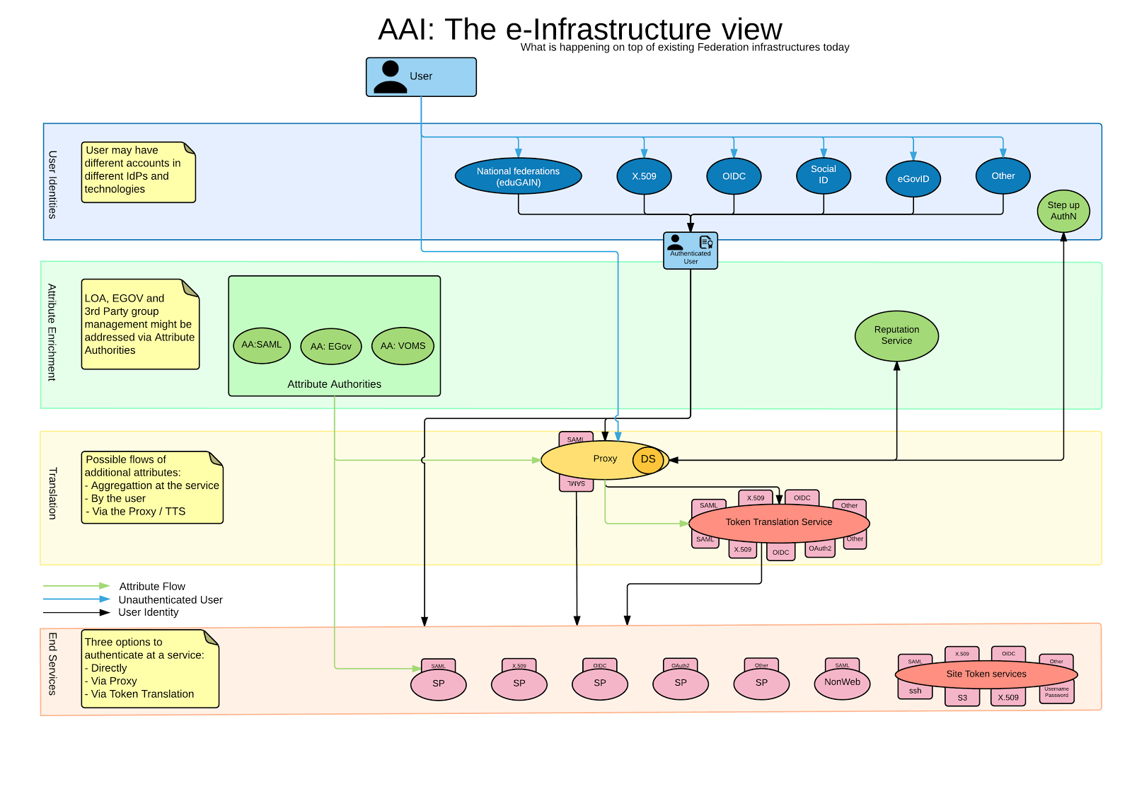

AARC Blueprint Architecture
(1st Draft)
User Community
Requirements
https://goo.gl/kSxENp
https://wiki.geant.org/display/AARC/AARC+Architecture

Slide 15
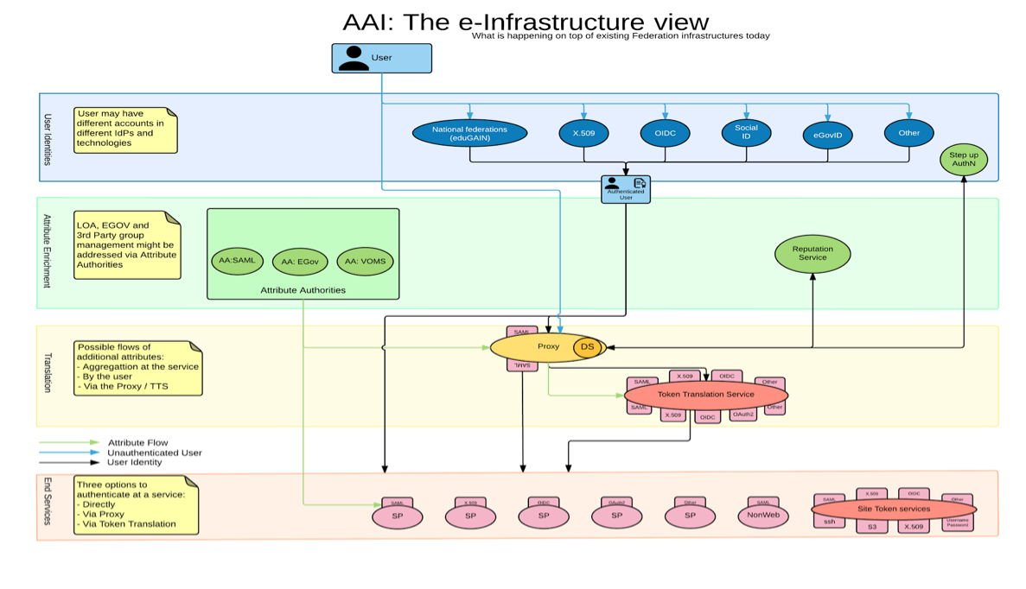

AARC Blueprint Architecture & eduGAIN
eduGAIN and the Identity Federations
A solid foundation for federated access in R&E
Authentication and Authorization Architecture
for Research Collaboration
A set of building blocks on top of eduGAIN
for International Research Collaboration

Slide 16
Why the proxy model?
All internal Services can have one statically configured IdP
No need to run an IdP Discovery Service on each Service
Connected SPs get consistent/harmonised user identifiers and accompanying attribute sets from one or more AAs that can be interpreted in a uniform way for authZ purposes
External IdPs only deal with a single SP proxy
But it comes with each own new challenges

Slide 17
Policies & Sustainability models
Security Incident Response Trust Framework for Federated Identity
  https://refeds.org/sirtfi
Minimal Assurance Level for low-risk research use cases
  https://wiki.geant.org/display/AARC/LoA+-+Level+of+Assurance
Policy and sustainability models for a pan-European Token Translation Service
  https://www.rcauth.eu/
Sustainability models for ”Guest IdPs”
  https://wiki.geant.org/display/AARC/Sustainability+models+for+Guest+IdPs
Requirements for Accounting and Data Protection
  https://wiki.geant.org/display/AARC/Accounting+and+Data+Protection

Slide 18
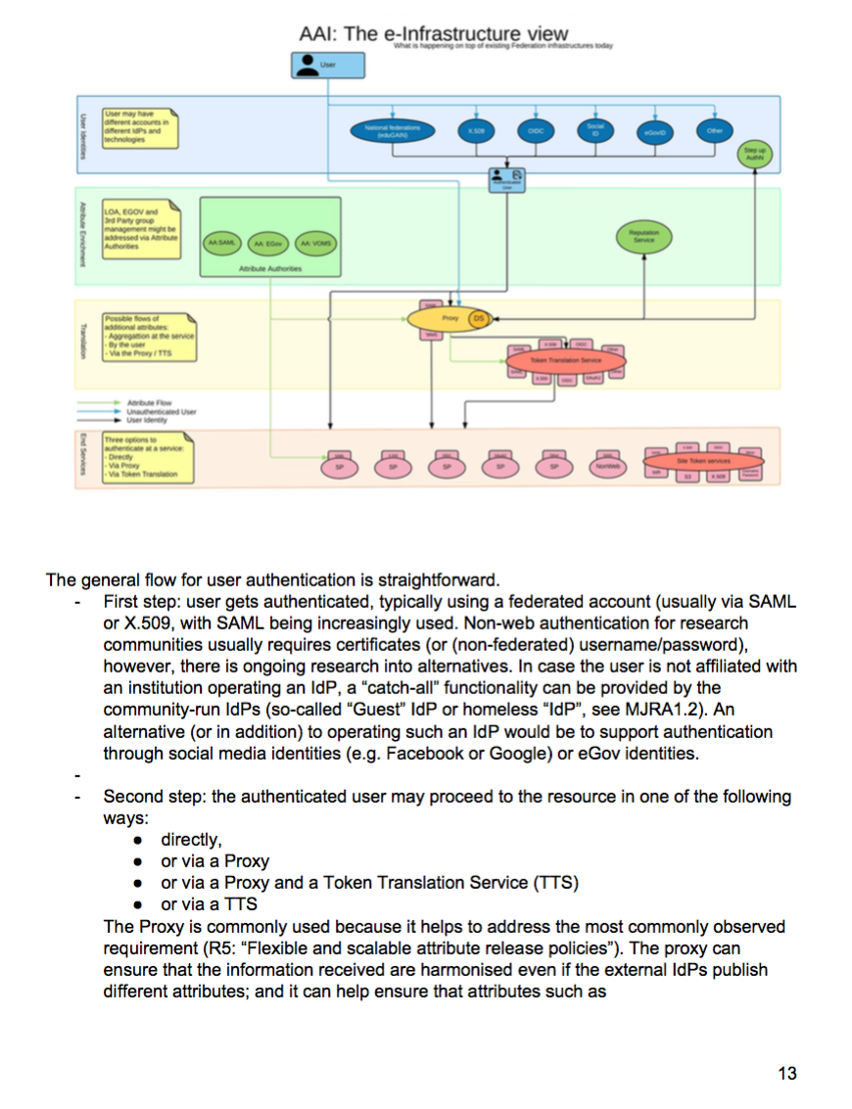
Pilots
Pilots
With Communities
Requirements
User Community
Overview Available
AAI Components
Draft Blue-Print
Architecture
Plan
Develop
Test
Include Feedback
Input for training
Package /release
https://goo.gl/kSxENp
https://goo.gl/NzQA2U
https://goo.gl/7dZZF4
aarc-project.eu

Slide 19
Pilots
IdPs
Library, hybrid AuthN
Library, IdP-SP proxy approach
Attribute Authorities
Perun and COmanage AAs for BBMRI & EGI
OpenConext attribute aggregation
Proxy
Token Translation
TTS with CI-logon and VO portal for Elixir
ORCID SP, LoA Elevation, Reference implementation of the BPA…
Service Provider
https://goo.gl/kSxENp
https://goo.gl/NzQA2U
https://goo.gl/7dZZF4
https://wiki.geant.org/display/AARC/AARC+Pilots

Slide 20
First e-Infrastructure implementations
EGI CheckIn Service
https://wiki.egi.eu/wiki/AAI
ELIXIR AAI
https://www.elixir-europe.org/services/compute/aai
EUDAT B2ACCESS
https://www.eudat.eu/services/b2access
GÉANT eduTEAMS
https://www.eduteams.org
https://goo.gl/kSxENp
https://goo.gl/NzQA2U
https://goo.gl/7dZZF4

Slide 21
Upcoming work
Policies and best practices for proxy operators
Framework recommendations for RIs for coherent policy sets
Guideline documents
(e.g. group Membership, non-web access, authorizaton)
Feasibility study for the use eGOV/eIDAS e-IDs
Pilots, pilots, pilots…
Focused trainings

Slide 22
skanct@admin.grnet.gr

